Slide 1

Menus and Standardized Recipes
Provided by the LAUSD Food Services Division
8.22.24
Notes:
TELL: We are here today to learn menus and standardized recipes. Before we begin please complete the pre-quiz located in your binder. Answer the questions to the best of your ability. We will review the pre-quiz answers together before beginning this presentation. At the completion of this training, there will be a review quiz to assess what you have learned.

Slide 2
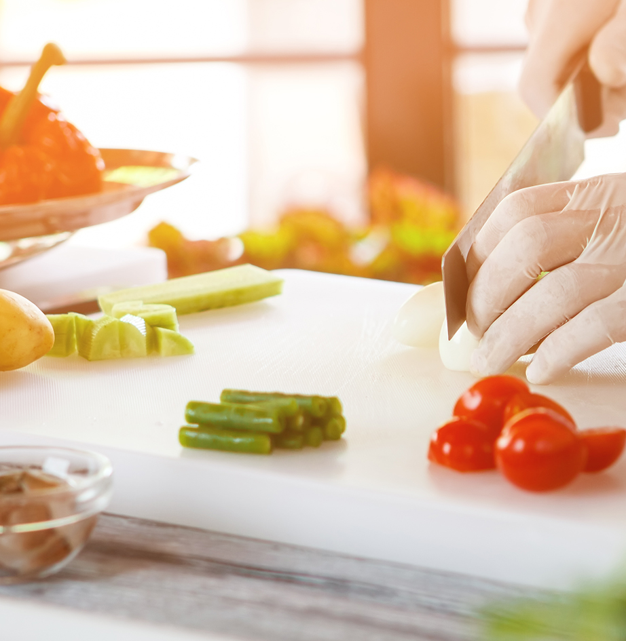
Why Use a Recipe?
The purpose of a recipe is to have a precise record of the ingredients used, the amount needed, and the way they are combined to ensure a consistent quality product for our customer.

Slide 3

Café LA Standardized Recipes
Using a recipe helps to develop an understanding of the menus and food preparation processes, such as:
What ingredients are required
What is the standardized cooking temperature and time
How to adjust measurements according to number of servings
How to keep food cost down

Slide 4

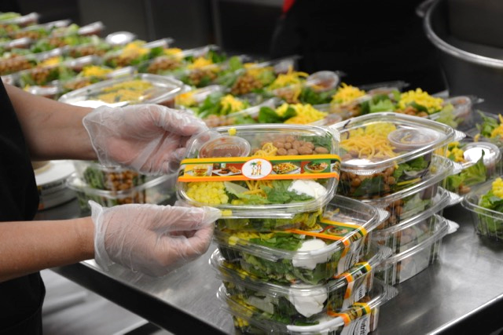
The Gold Standard in Food Quality
What is the Gold Standard?
The optimal sample menu item from which other items are to be modeled after.
Follows standardized recipes
Why is the Gold Standard important?
Controls food & labor cost
Provides a visually appealing product

Slide 5
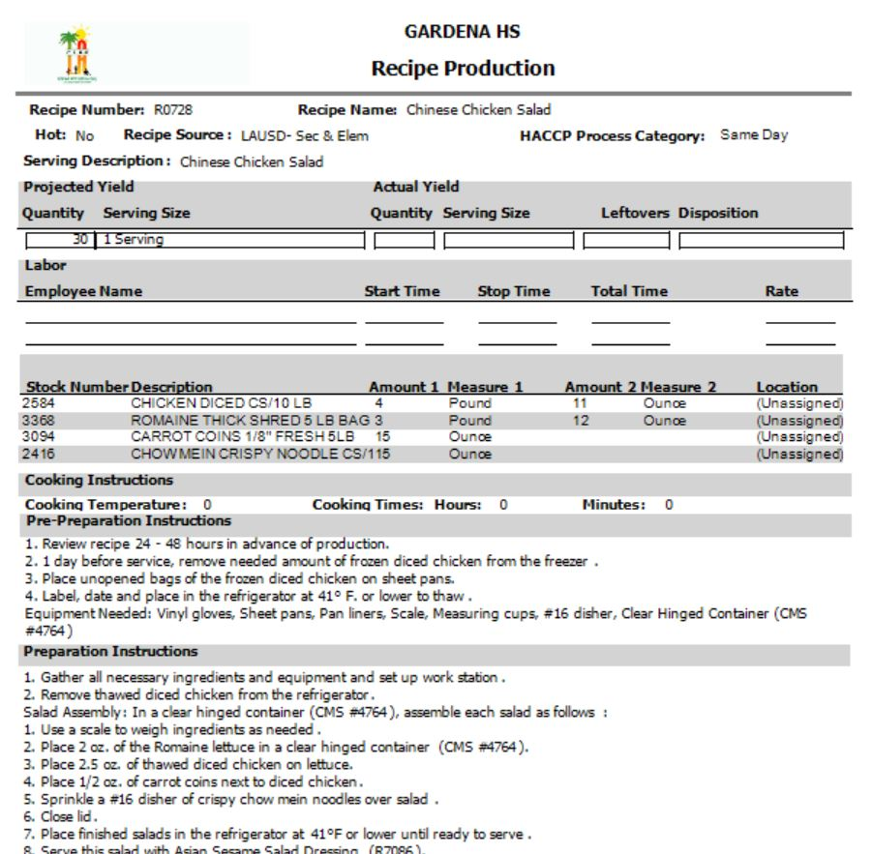
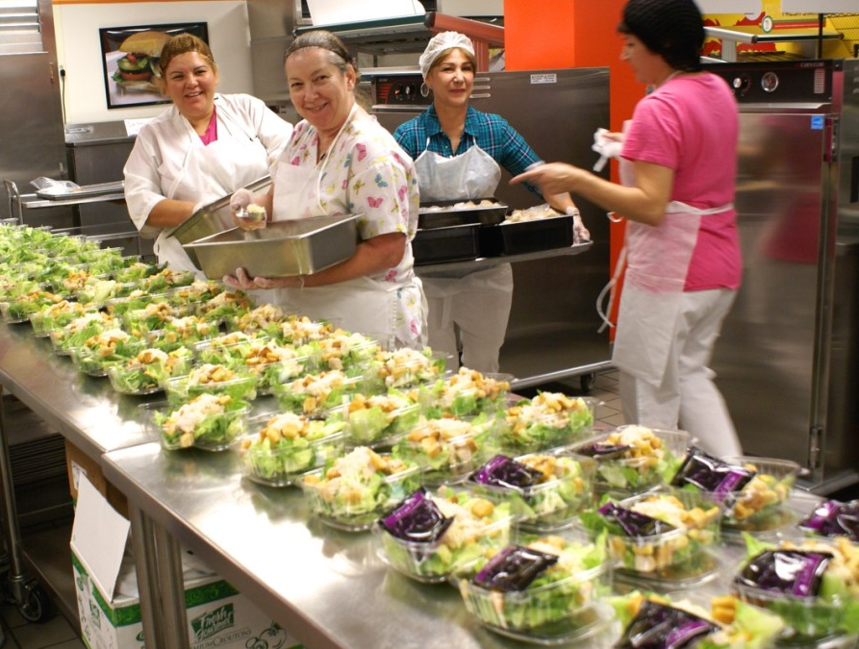
Recipe to Plate
Step 1
Locate Menu on CMS
Step 2
Gather all ingredients and prepare

Slide 6
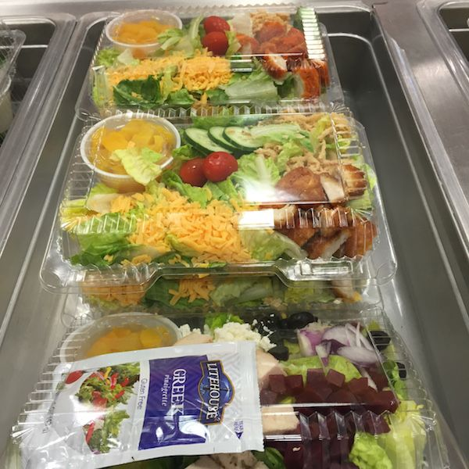

Recipe to Plate
Step 3
Store and serve items properly
Step 4
Students eat and enjoy!

Slide 7
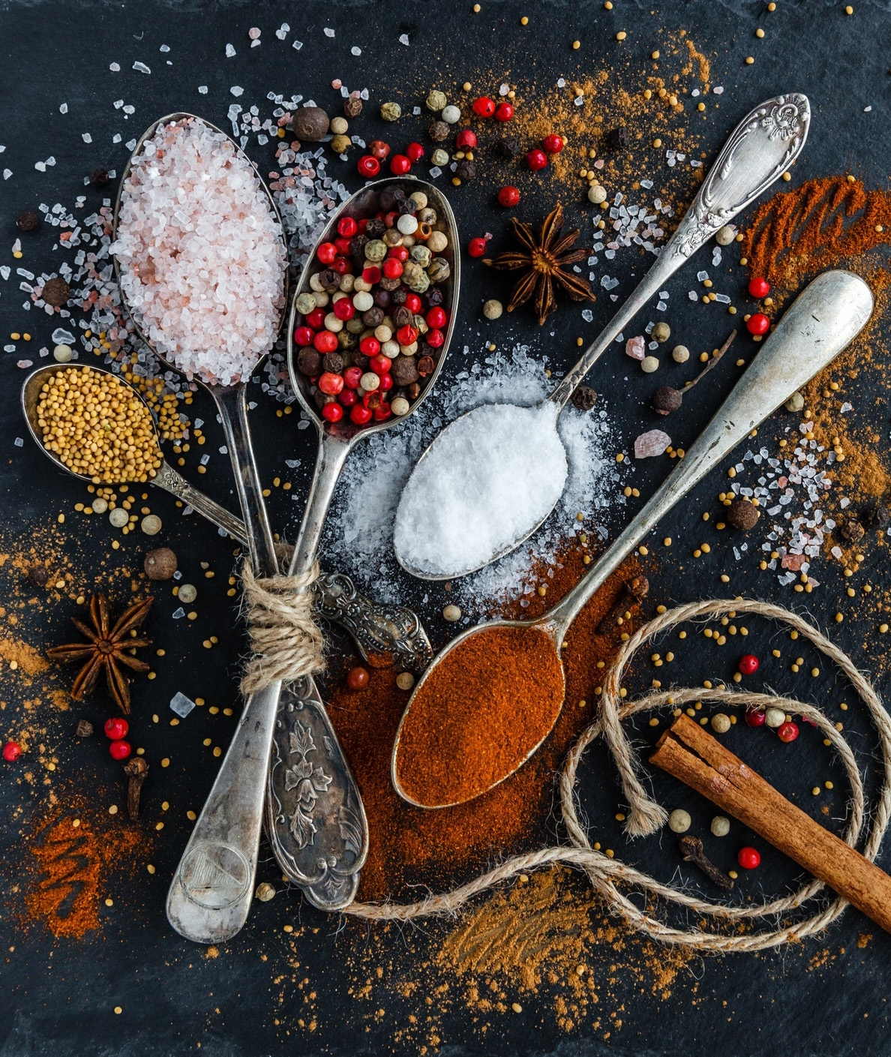
Menu Facts
Menus must be read and followed as written. Menu Items must be presented as written.
If items are listed to be served together they must be served as a unit.
Every item on the menu has a specific recipe. Following recipe ensures a consistent product every time.

Slide 8



Different Menus
Menus are planned and designed according to the Food Base Menu Planning (FBMP) for specific grade levels:
Grades K – 5
Grades 6 – 8
Grades 9 – 12

Slide 9
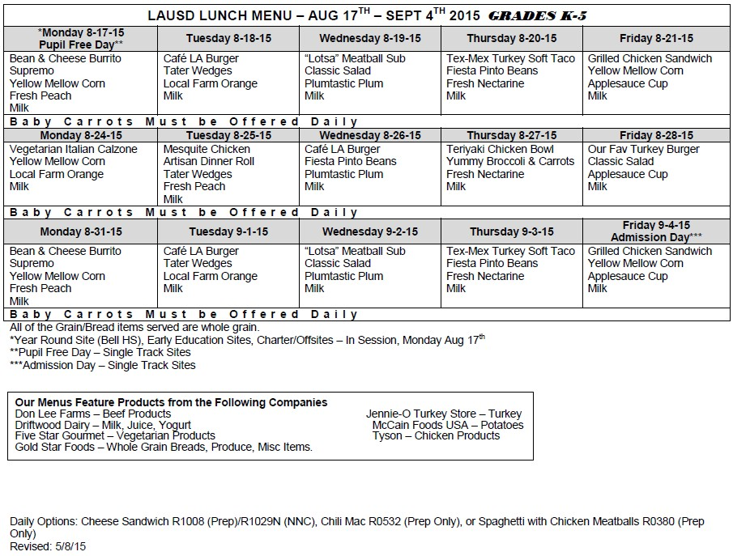
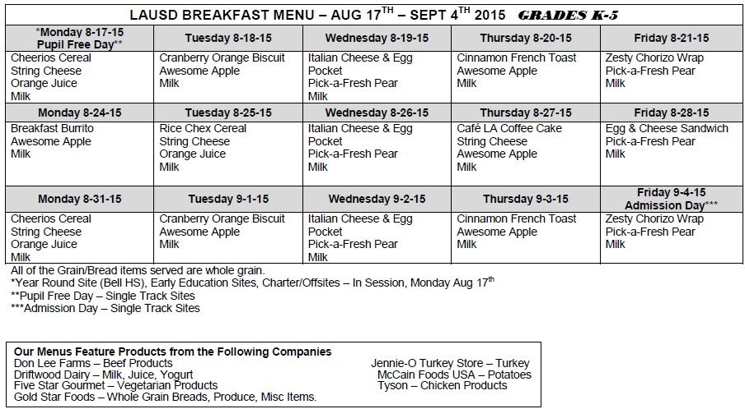
Menus: Grade K – 5
Breakfast Menu
Lunch Menu

Slide 10
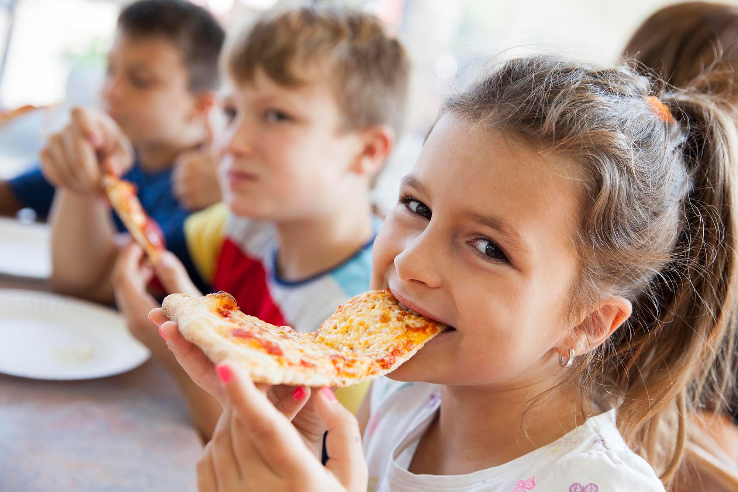
Reduced Temperature for Safety
To avoid young children from burning themselves, hot food must be cooled to between 135° – 137° before serving to students at:
EEC Centers
State Preschools
Pre-K thru 5th grades

Slide 11
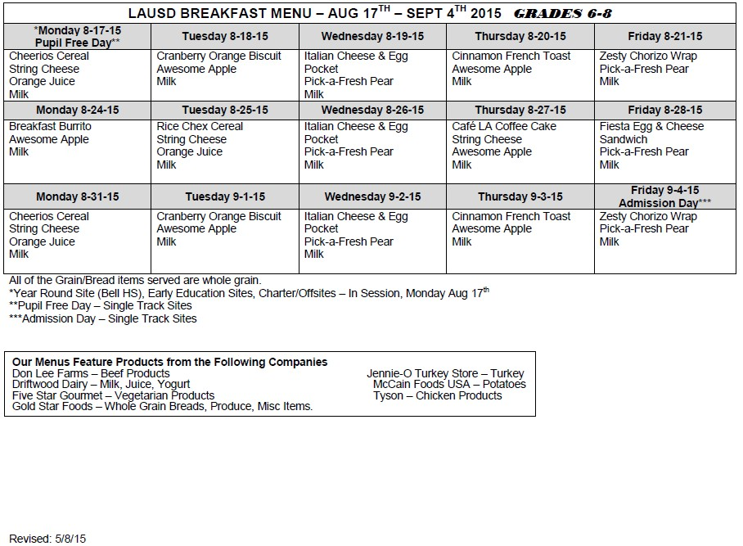
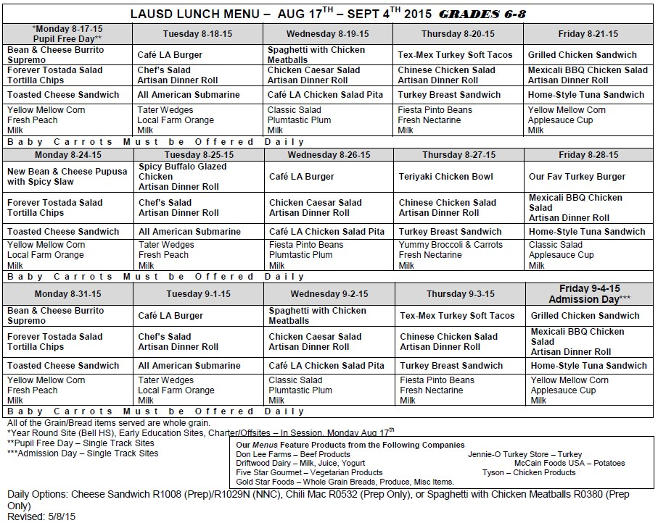
Menus: Grade 6 – 8
Breakfast Menu
Lunch Menu

Slide 12
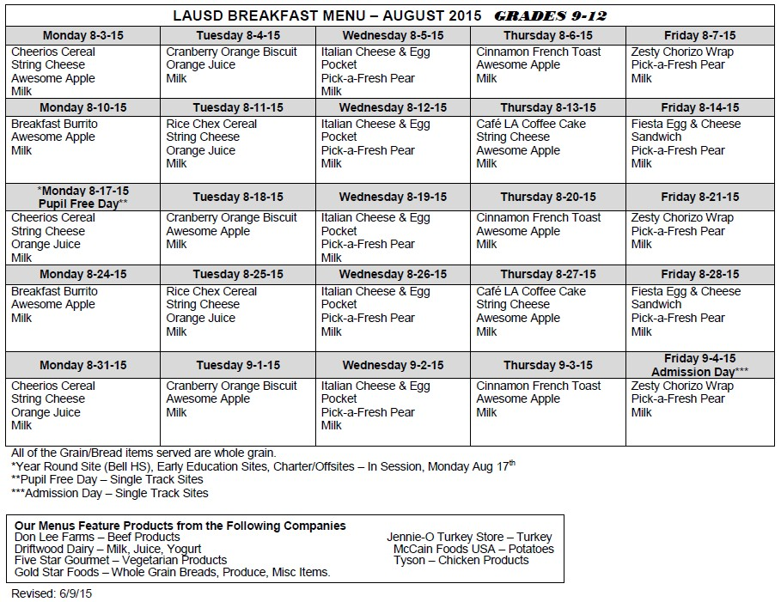
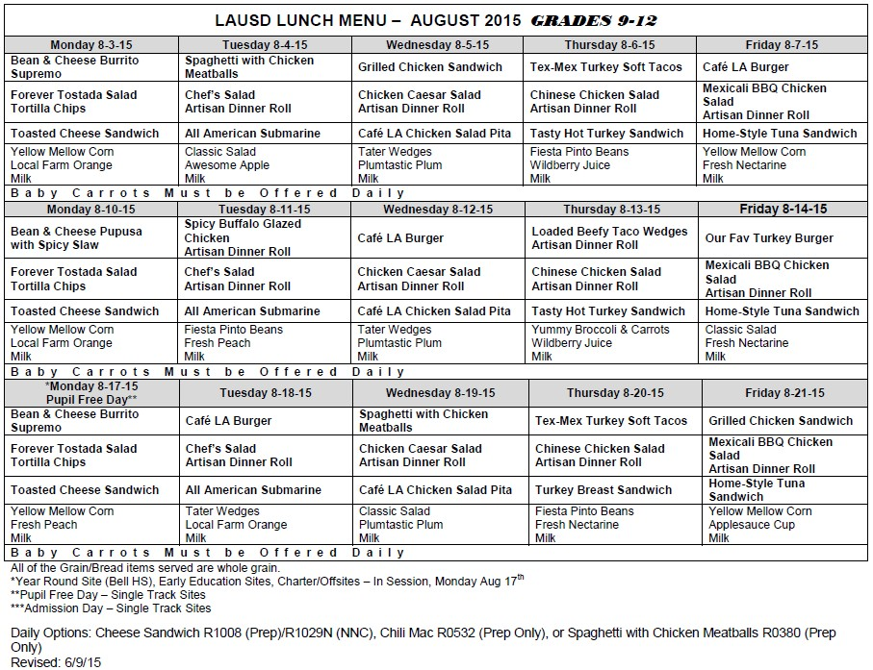
Menus: Grade 9 – 12
Breakfast Menu
Lunch Menu

Slide 13
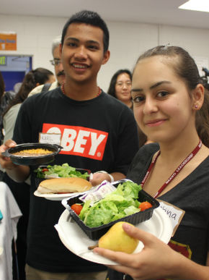
Different Caloric/Nutrient Requirements
Follow the correct menu and items for the grade levels serving.
The menus have different calorie and nutrient counts that are only appropriate the grade level being served.

Slide 14
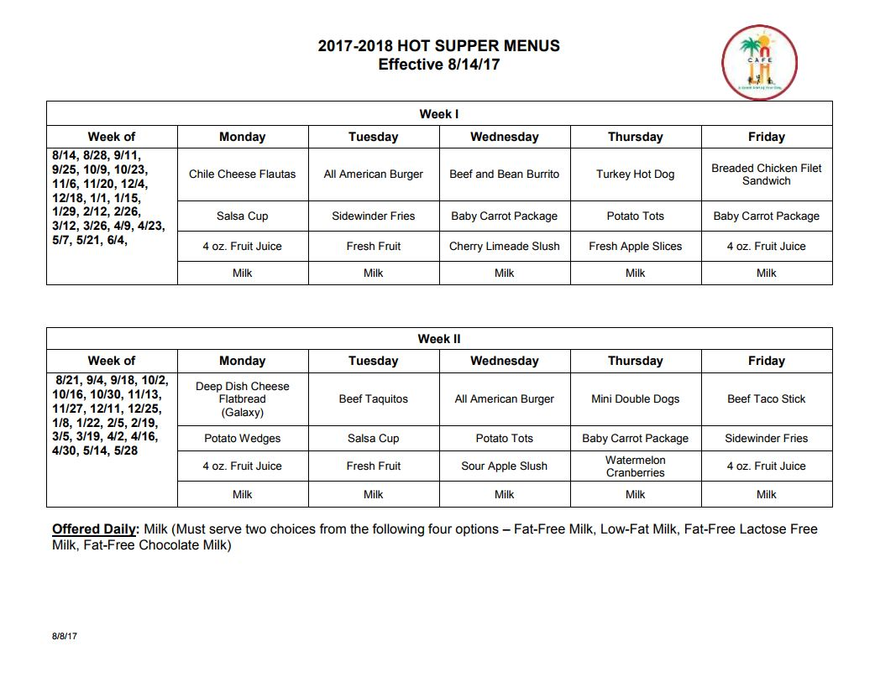
Menus: Supper Grade K – 12
Supper Menu
Follow the correct menu according to the school's sites menu plan:
Hot Supper- Items that require heating preparation and fresh fruit offerings.
Cold Supper- Refrigerated items that require no heating to prepare.

Slide 15
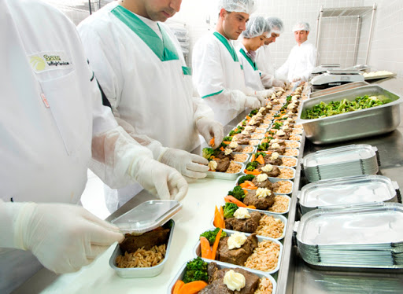
What is a Standardized Recipe?
Standardized recipes are used every day as a guide to preparing the foods served to customers.
A standardized recipe has been carefully adapted and tested to ensure a consistent product every time

Slide 16
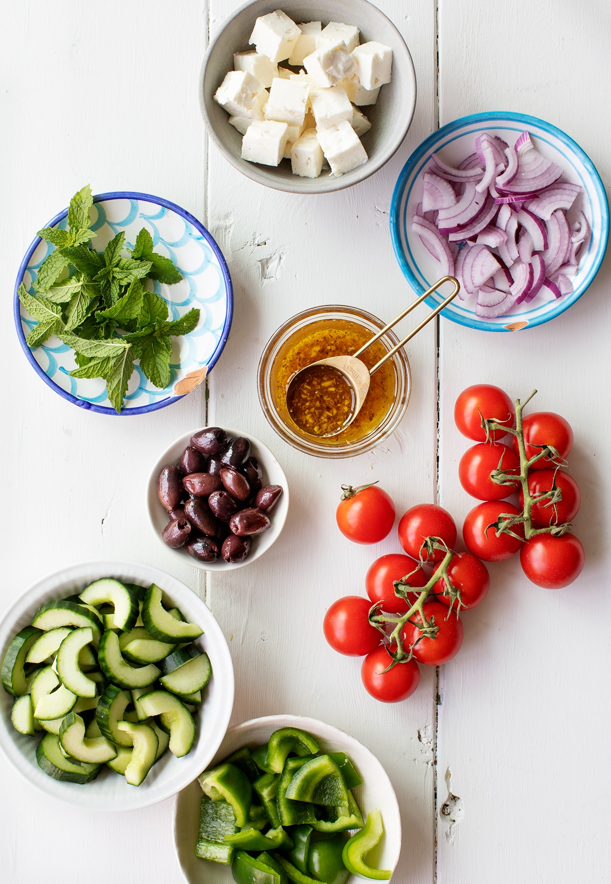
Standardized Recipe Benefits
The recipe is directly linked to multiple functions within the cafeteria:
Menu: Food Base Menu Planning
Factoring and Forecasting
Ordering and Receiving
Production Record
Point of Service
Claim for Reimbursable Meals

Slide 17
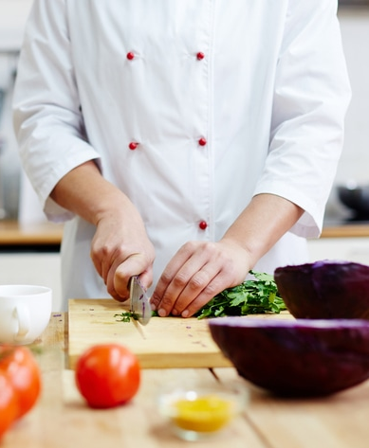
Recipe Facts
Recipes must be followed as they are written. Do not assume the recipe is the same as the previous year, regardless of the recipe name
Recipes may have been revised
Discard all old recipes and print new ones for master recipe book
Recipes must be utilized for every menu item

Slide 18
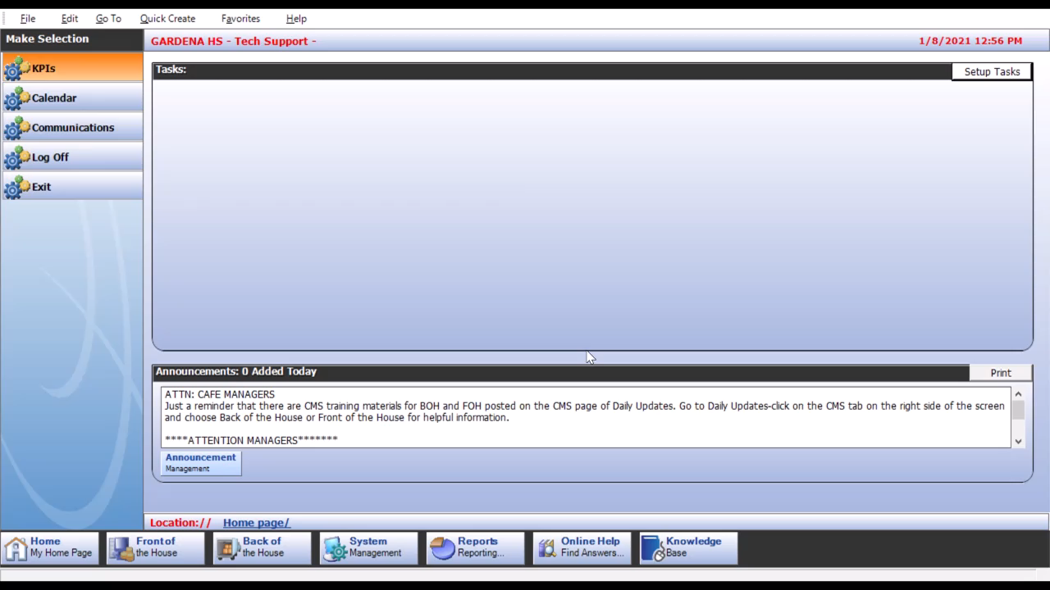
Locating the Recipes
All recipes are located in OneSource. To find a recipe, go to: Reports > Menu Planner > Recipe Production

Slide 19
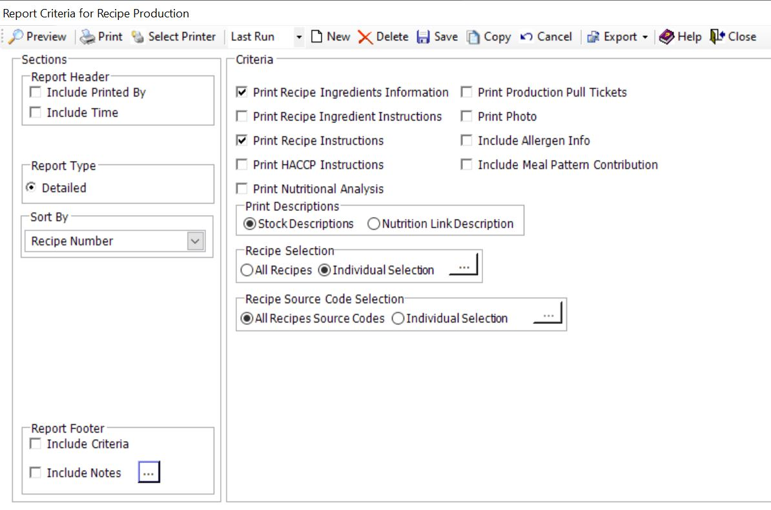
Choosing the Recipe Criteria
The Criteria screen is where you choose the information to be displayed on your recipe.
Sort by
Recipe Number
Recipe Name
Choose the Criteria
Individual Selection
Click the Ellipsis […]
Preview

Slide 20
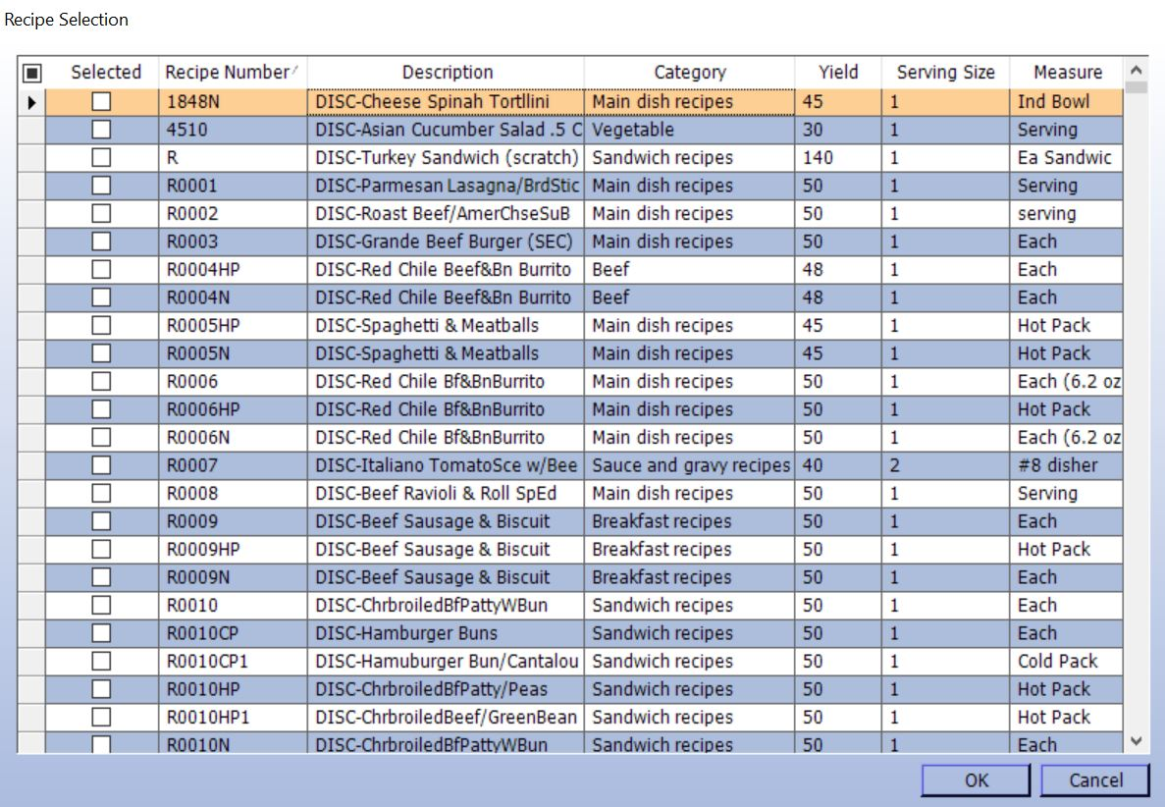
Sorting the Recipes
To locate the recipe needed, you will need to:
Deselect all previous recipes by clicking the small shaded box in the upper top left corner
Recipes may be sorted by:
Recipe Number - Description - Category - Yield - Serving Size- Measure

Slide 21
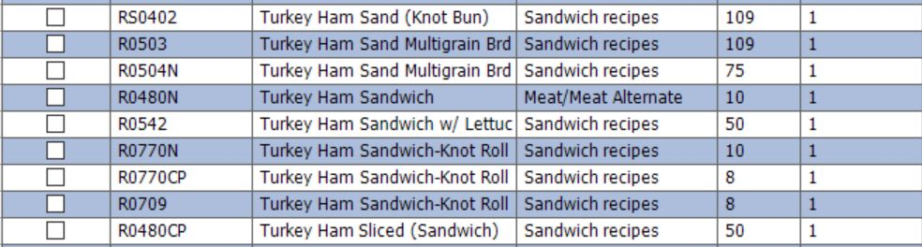
Selecting the Correct Recipes
Many recipe items sound exactly the same. Pay close attention to the recipe number. Despite sounding similar, the recipe instructions can be vastly different.
A standard recipe will begin with “R” followed by a 4-digit recipe number and contain no other letters.
A recipe ending with “N” or “CP” means this recipe are for items prepared and sent from central kitchen (NNC).

Slide 22
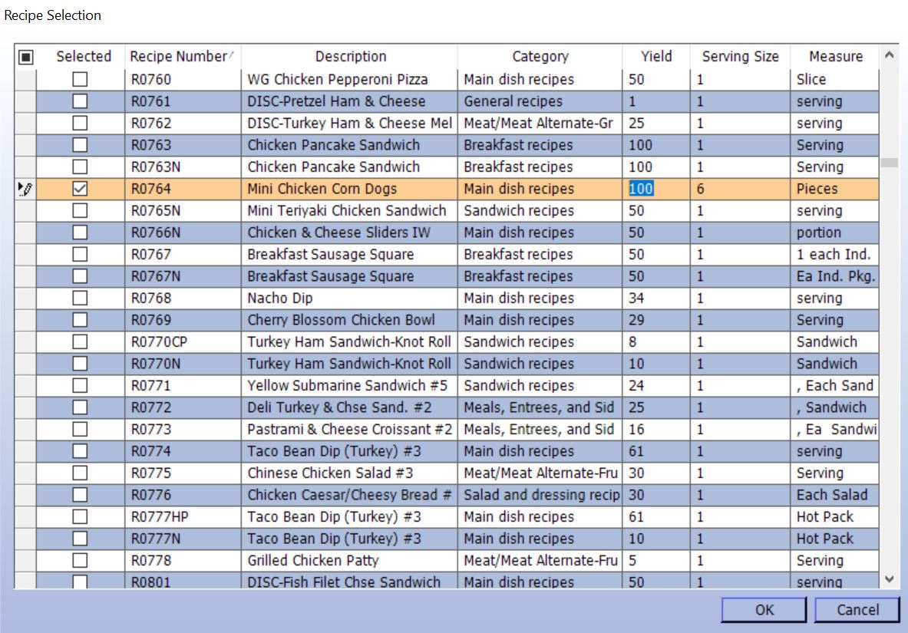
Select and Adjust the Recipe
The recipe yield can be adjusted to the specific amount being served. To do this:
Select the recipe
Click in the Yield column
Type the preferred amount
Click OK

Slide 23
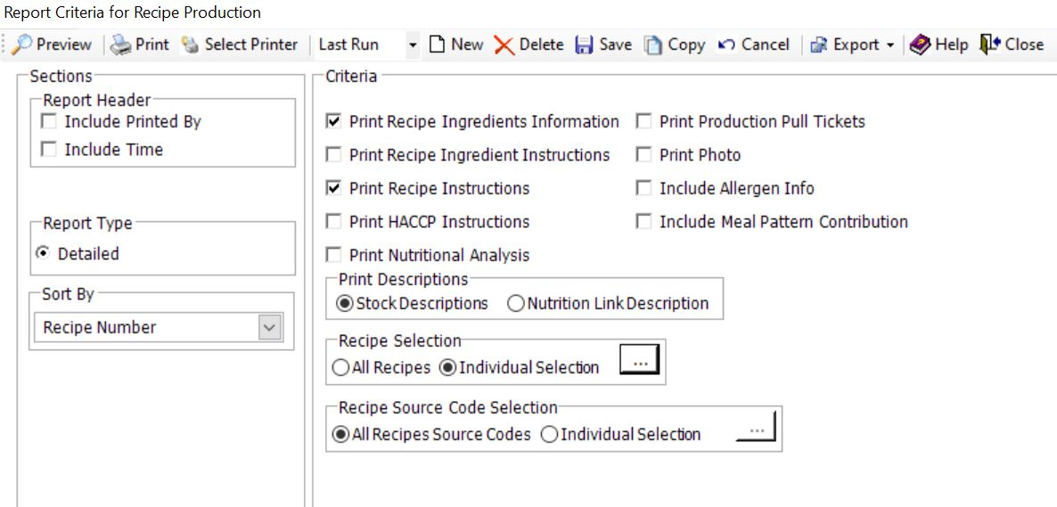
Preview the Recipe
Select “Preview” to display the recipe.
Note: Verify the yield is correct prior to printing.

Slide 24
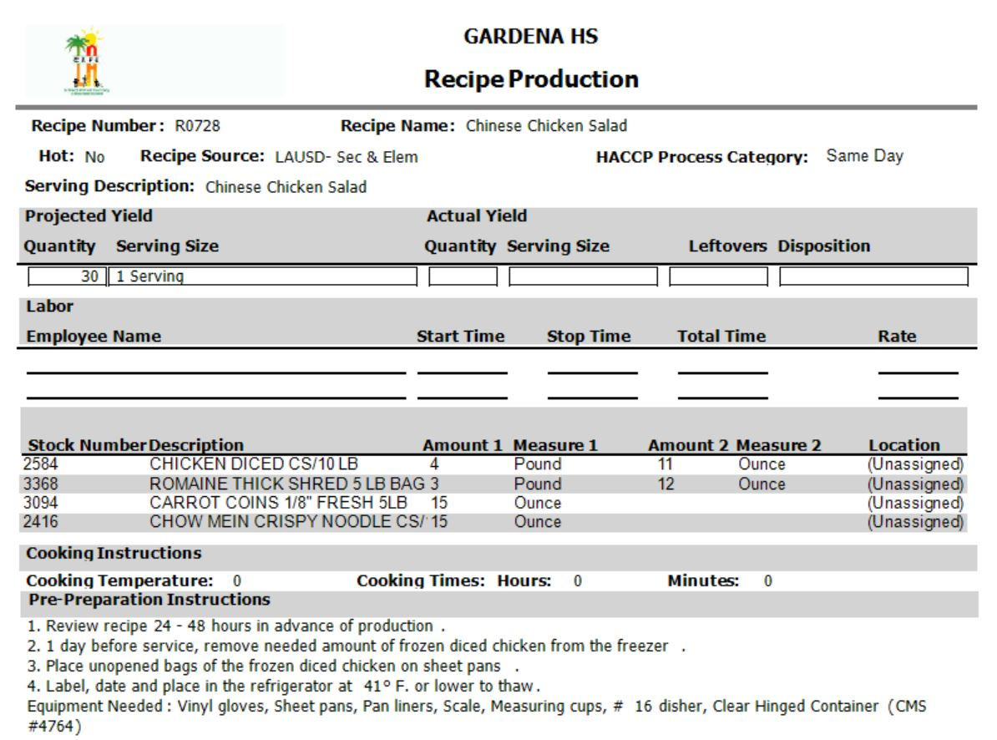
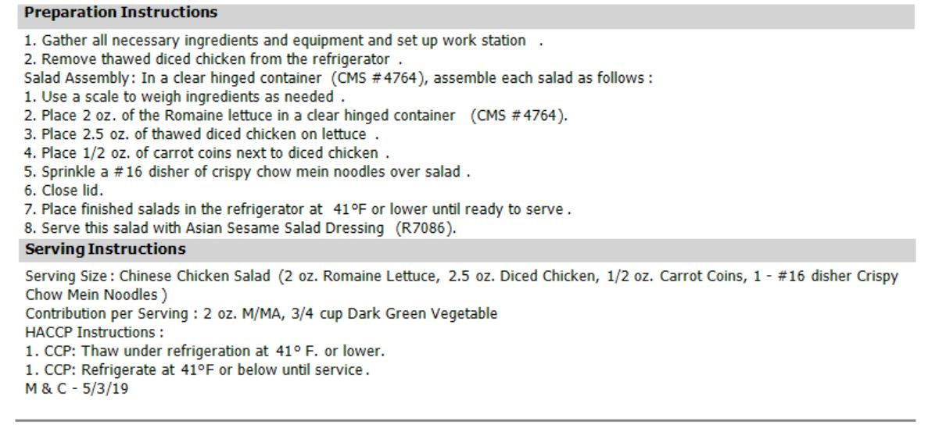
Recipe Contents
Recipes will contain:
Recipe Number
Recipe Name
Ingredients
Instructions
Cooking
Pre-Preparation
Preparation
Serving
HACCP
Nutritional Content

Slide 25
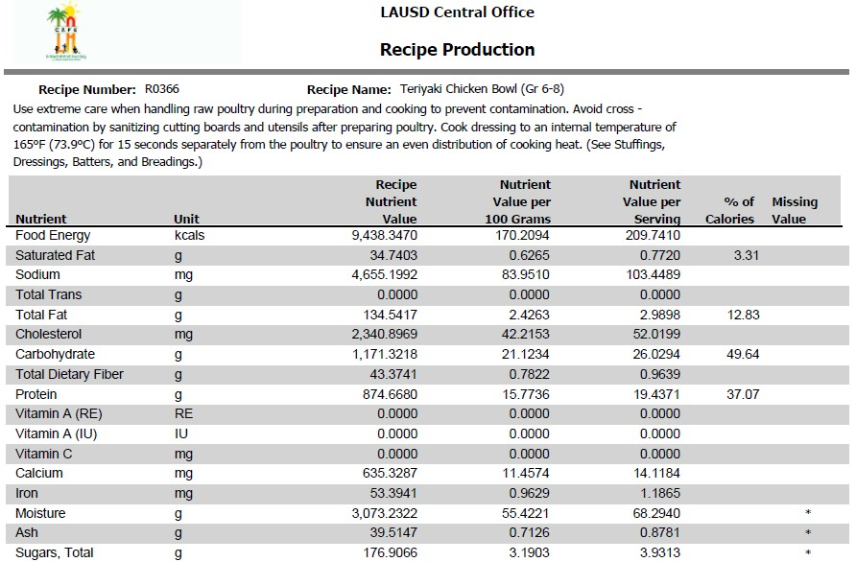
Recipe Contents: Nutrients
The nutrients listed in this section include:
Food Energy (calories)
Fat Contents
Sodium
Cholesterol
Carbohydrates
Protein
Vitamins

Slide 26
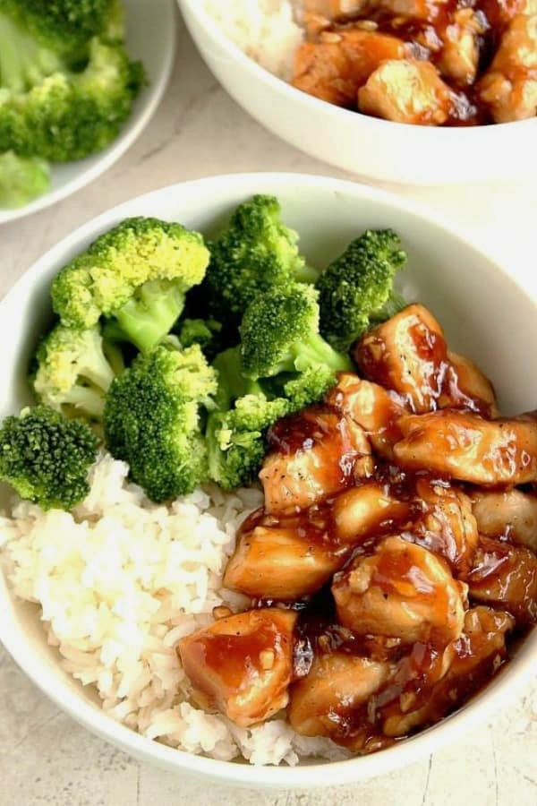
Complex Recipes
Some recipes only require the preparation of one item. Other recipes require that multiple ingredients within the recipe each have their own recipe instructions.
Example: Teriyaki Bowl

Slide 27
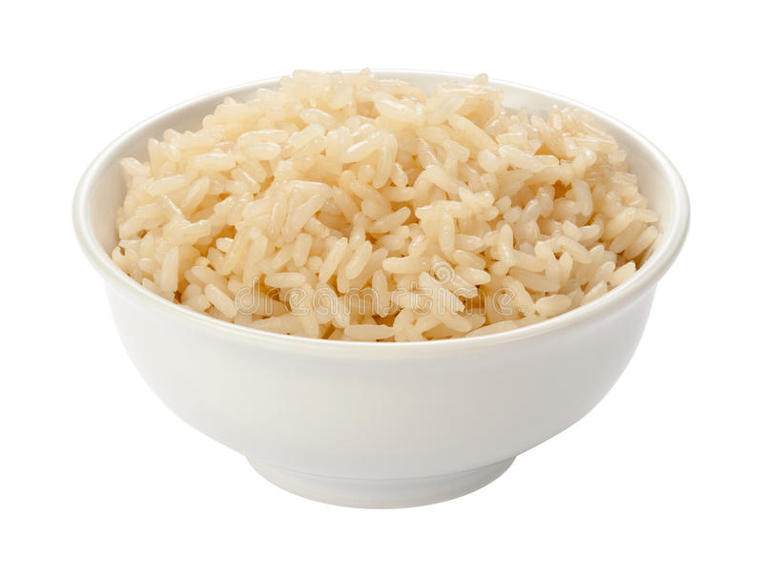
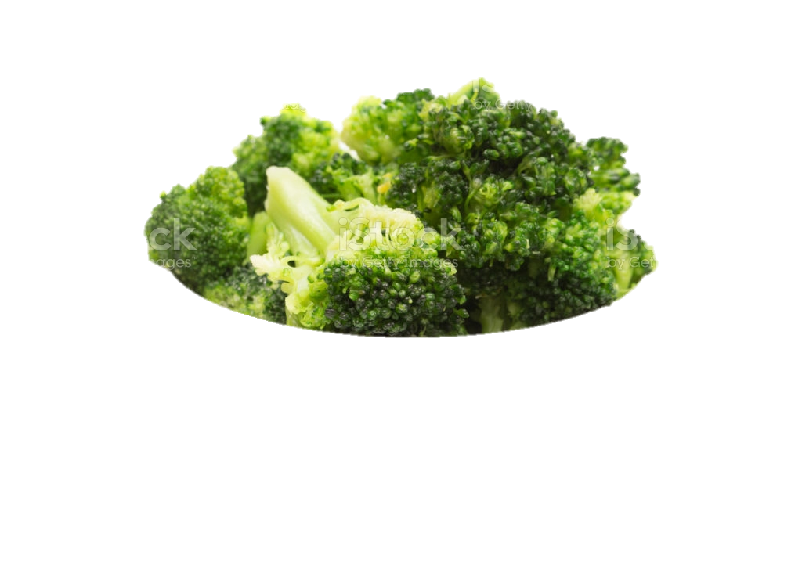
Simple vs. Complex Recipe
A simple recipe deals with only one ingredient and relies on no other ingredients to complete. (ex: Steamed Broccoli, Brown Rice)

Slide 28
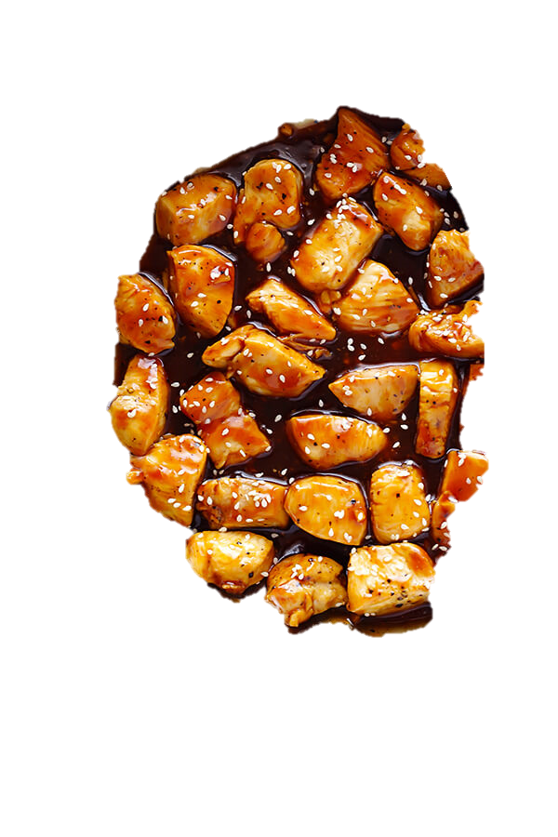
Simple vs. Complex Recipe
A complex recipe will consist of several ingredients, and several recipes which need to be prepared beforehand in order to assemble and complete (ex: Teriyaki Chicken Bowl).

Slide 29
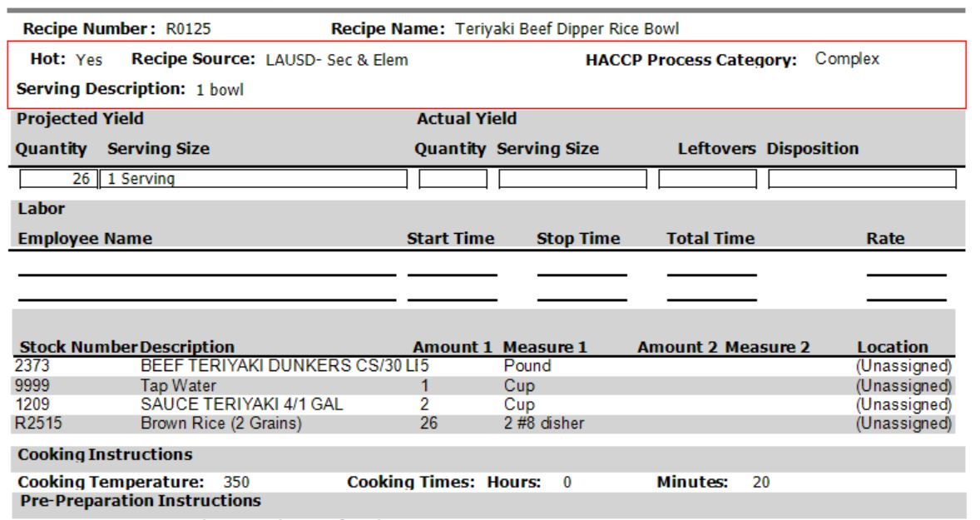
Complex Recipe
This recipe requires that one of its ingredients is prepared with its own recipe before hand. In this example the brown rice is listed with a recipe number, “R2515.”

Slide 30
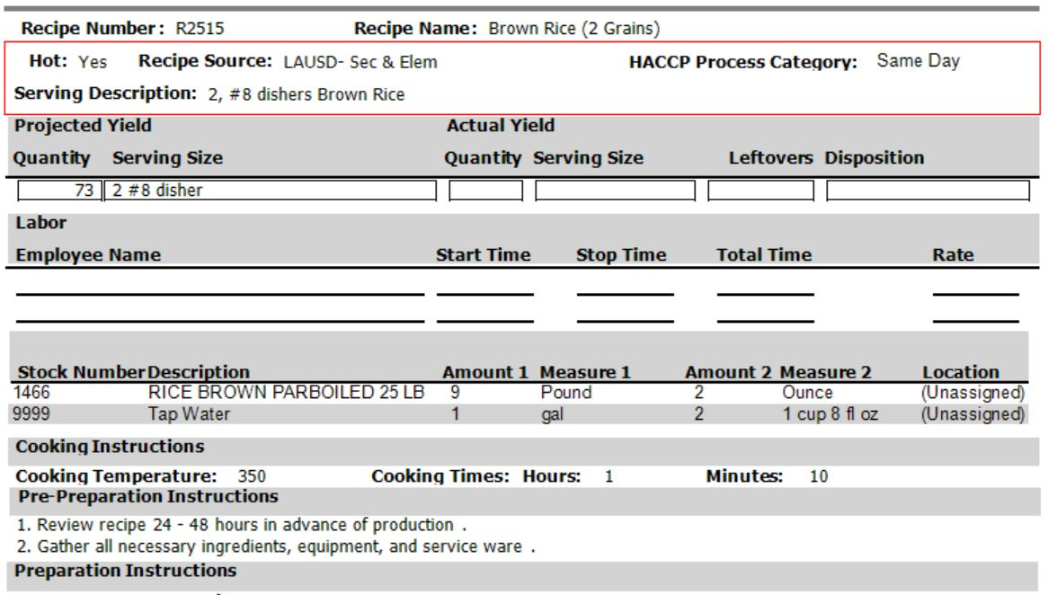
Complex Recipe
Before being able to assemble the Teriyaki Bowl, the recipe for brown rice must first be completed.

Slide 31
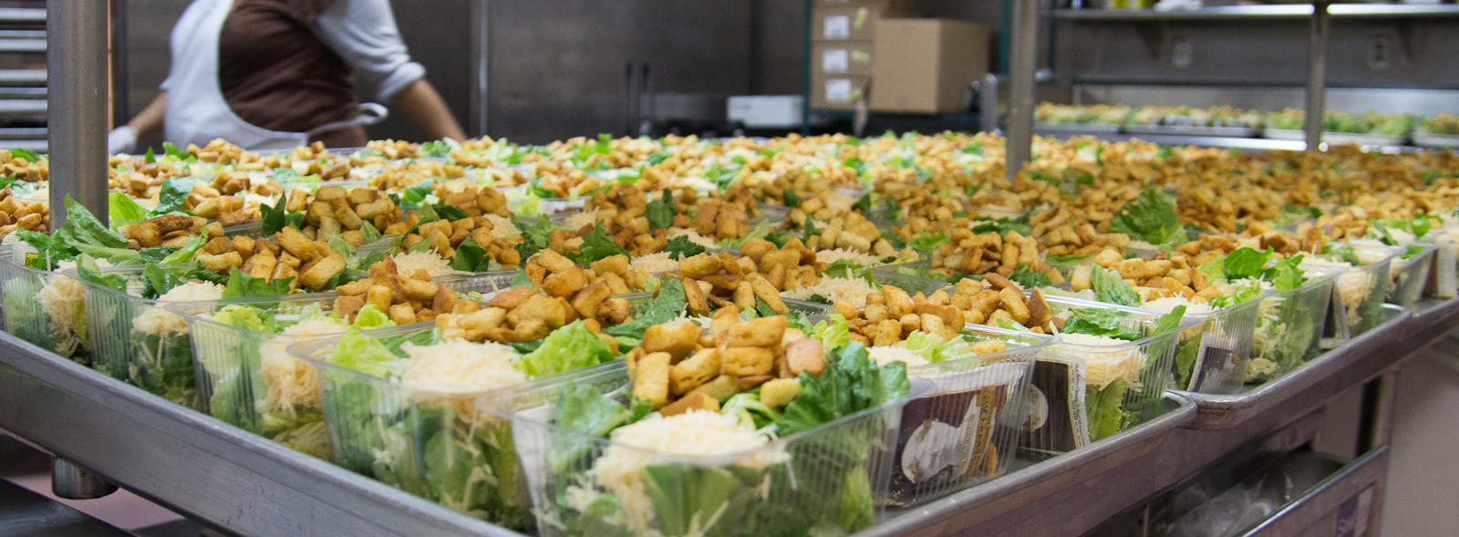
Who Should Follow Recipe?
The standardized recipe should be followed by everyone, every time the menu item is being prepared (ex: Manager, Senior, FSW, Sub.)
It does not matter how many times one has prepared the item or how many years they have worked in the kitchen.

Slide 32

Importance of Following Standardized Recipe
Consequences of not following a standardized recipe include:
Inconsistent food quality
Non – nutritional value
Incorrect portioning
Unbalanced costs
Customer dissatisfaction
Disproportionate nutrients per serving
Over/under producing

Slide 33

Costs of Overproducing: “Playing it Safe”
Based on forecasted need, the cafeteria requires 512 servings of “Mac and Cheese”:
The site decides to produce an additional 25 servings
At the end of service 27 servings were leftover
The extra 25 servings increased the food cost by $9.04
164 sites overproduce 25 servings
164 sites X $9.04 = $1,482.56
$1482.56 x 180 school days = $266,860.80 per year!

Slide 34
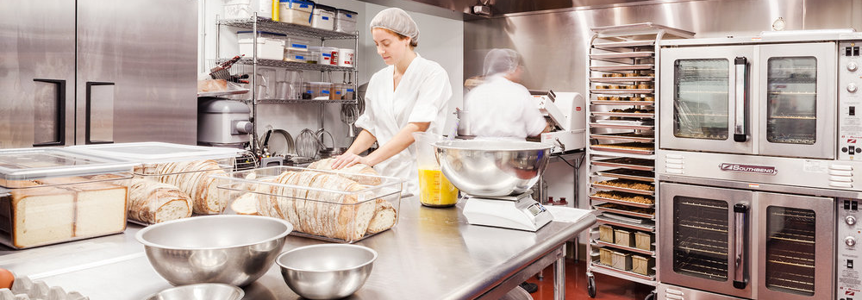
Batch Cooking
Batch cooking is defined as cooking to the line or just-in-time preparation.
Preparing food in small batches as needed throughout the serving period, preserves food quality and prevents excessive waste due to leftovers.

Slide 35

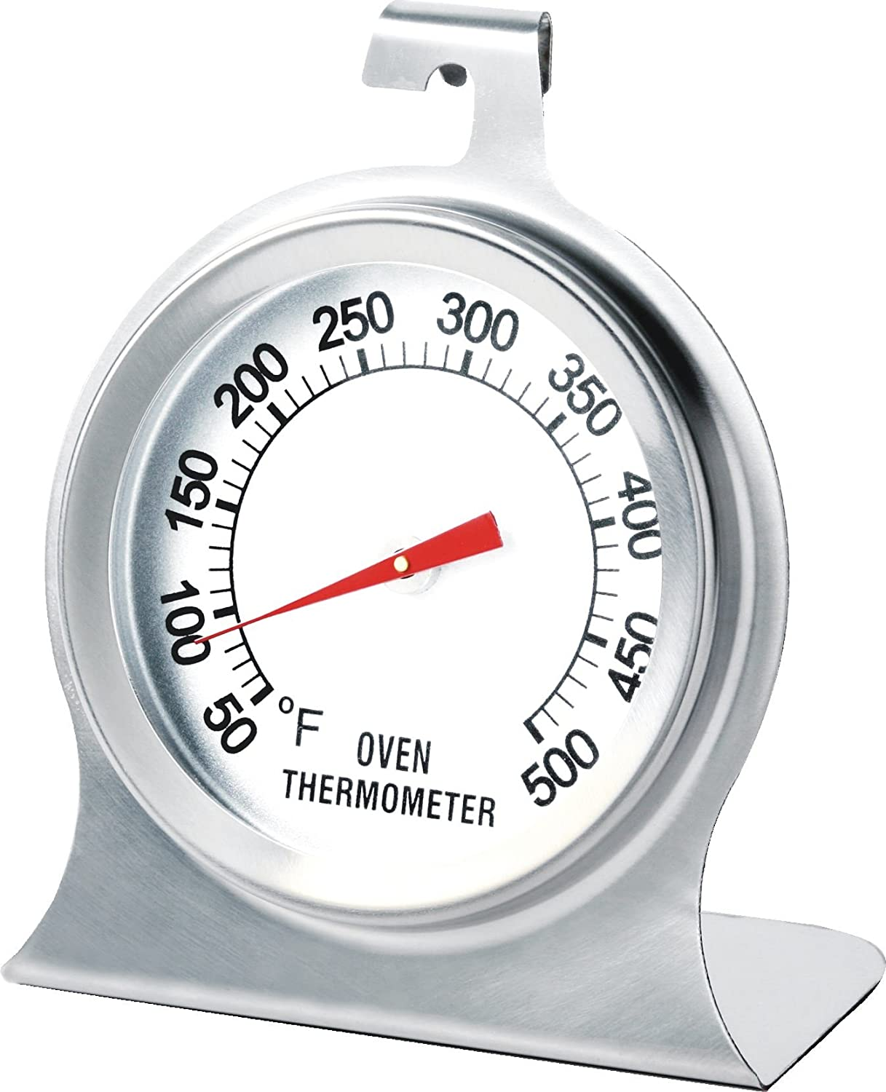
Batch Cooking Guidelines
There are several factors to consider when batch cooking.
Serving Times
Breakfast vs. Lunch
Multiple serving periods
School Site versus Off-Site
Forecasted demand per serving period/line
Cooking Times
Order of items that need to be cooked
Quality of food held/effected during holding periods

Slide 36
Batch Cooking Example
Lunch service at ABC Elementary is from 11-1pm. Group 1 is first in line at 11:00, then followed by the Group 2 at 11:45 and lastly, Group 3 at 12:30.
Todays lunch item takes 20 minutes to cook and 5 minutes to assemble. What time should the first batch go into the oven for Group 1?
10:00am: the first batch will take 20 min. to cook and 5 min. to assemble.
10:25 am: food can be stored in the warmer.
11 am: Group 1 arrives. Food quality will not be compromised since it is held for less than 1hr.
A) 9:35am
B) 10:00am
C) 10:45am
D) Throw everything in oven after breakfast

Slide 37
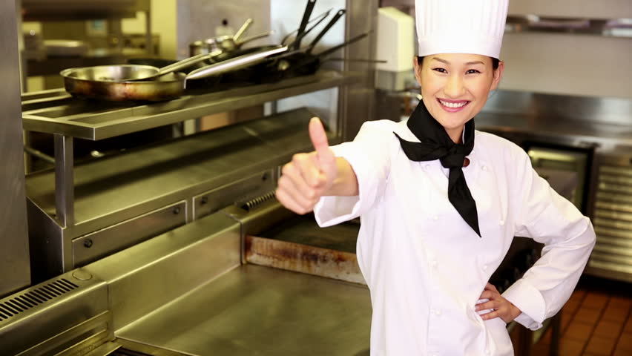
Recap
Today, we have learned:
Menus are developed according to grade levels
Where to find recipes
How to change the yield
How to read the recipe
The importance of following a standardized recipe
The negative effects of not following the recipe

